Slide 1
Statistical Inference
Hypothesis Testing

Slide 2
Hypothesis Testing
Testing a Claim: Companies often make claims about products. For example, a frozen yogurt company may claim that its product has no more than 90 calories per cup. This claim is about a parameter – i.e., the population mean number of calories per cup (μ).
The claim is tested is by taking a sample - say, 100 cups - and determining the sample mean. If the sample mean is 90 calories or less we have no evidence that the company has lied. Even if the sample mean is greater than 90 calories, it is possible the company is still telling the truth (sampling error). However, at some point – perhaps, say, a sample average of 500 calories per cup – it will be clear that the company has not been completely truthful about its product.

Slide 3
Hypothesis Testing
A hypothesis is made about the value of a parameter, but the only facts available to estimate the true parameter are those provided by the sample. If the statistic differs (and of course it will) from the hypothesis stated about the parameter, a decision must be made as to whether or not this difference is significant. If it is, the hypothesis is rejected. If not, it cannot be rejected.
H₀: The null hypothesis. This contains the hypothesized parameter value which will be compared with the sample value.
H₁: The alternative hypothesis. This will be “accepted” only if H₀ is rejected.
Technically speaking, we never accept H₀ What we actually say is that we do not have the evidence to reject it.

Slide 4
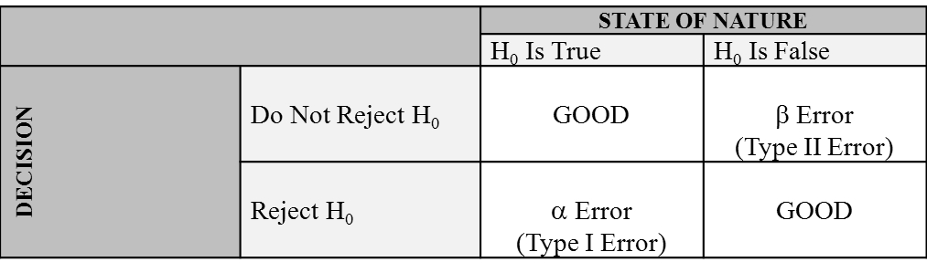
Two Types of Errors: Alpha and Beta
Two types of errors may occur: α (alpha) and β (beta). The α error is often referred to as a Type I error and β error as a Type II error.
You are guilty of an alpha error if you reject H₀ when it really is true.
You commit a beta error if you “accept” H₀ when it is false.

Slide 5
Two Types of Errors: Alpha and Beta
This alpha error is related to the (1- α) we just learned about when constructing confidence intervals. We will soon see that an α error of .05 in testing a hypothesis (two-tail test) is equivalent to a confidence of 95% in constructing a two-sided interval estimator.

Slide 6
Two Types of Errors: Alpha and Beta
TRADEOFF!
There is a tradeoff between the alpha and beta errors. We cannot simply reduce both types of error. As one goes down, the other rises.
As we lower the α error, the β error goes up: reducing the error of rejecting H₀ (the error of rejection) increases the error of “Accepting” H₀ when it is false (the error of acceptance).
This is similar (in fact exactly the same) to the problem we had earlier with confidence intervals. Ideally, we would love a very narrow interval, with a lot of confidence. But, practically, we can never have both: there is a tradeoff.

Slide 7
Tradeoff in Type I / Type II Errors: Examples
Our legal system understands this tradeoff very well.
If we make it extremely difficult to convict criminals because we do not want to incarcerate any innocent people we will probably have a legal system in which no one gets convicted.
On the other hand, if we make it very easy to convict, then we will have a legal system in which many innocent people end up behind bars.
This is why our legal system does not require a guilty verdict to be “beyond a shadow of a doubt” (i.e., complete certainty) but “beyond reasonable doubt.”

Slide 8
Steps in Hypothesis Testing
Formulate H₀ and H₁. H₀ is the null hypothesis, a hypothesis about the value of a parameter, and H₁ is an alternative hypothesis.
e.g., H₀: µ=12.7 years; H₁: µ≠12.7 years
Specify the level of significance (α) to be used. This level of significance tells you the probability of rejecting H₀ when it is, in fact, true. (Normally, significance level of 0.05 or 0.01 are used)
Select the test statistic: e.g., Z, t, F, etc. So far, we have been using the Z distribution. We will be learning about the t-distribution (used for small samples) later on.
Establish the critical value or values of the test statistic needed to reject H₀. DRAW A PICTURE!
Determine the actual value (computed value) of the test statistic.
Make a decision: Reject H₀ or Do Not Reject H₀.

Slide 9
One-Tail and Two-Tail Hypothesis Tests
When we Formulate H₀ and H₁, we have to decide whether to use a one-tail or two-tail test.
With a “two-tail” hypothesis test, α is split into two and put in both tails. H₁ then includes two possibilities: μ = # OR μ ≠ #. This is why the region of rejection is divided into two tails. Note that the region of rejection always corresponds to H₁.
With a “one-tail” hypothesis test, the α is entirely in one of the tails.

Slide 10
One-Tail and Two-Tail Hypothesis Tests
For example, if the company claims that a certain product has exactly 1 mg of aspirin, that would result in a two-tail test. Note words like “exactly” suggest two tail tests. There are problems with too much aspirin and too little aspirin in a drug.
On the other hand, if a firm claims that a box of its raisin bran cereal contains at least 100 raisins, a one-tail test has to be used. If the sample mean is more than 100, everything is ok. The problems arise only if the sample mean is less than 100. The question will be whether we are looking at sampling error or perhaps the company is lying and the true (population) mean is less than 100 raisins.

Slide 11
Two-Tail Tests
A company claims that its soda vending machines deliver exactly 8 ounces of soda. Clearly, You do not want the vending machines to deliver too much or too little soda. How would you formulate this?
Answer: H₀: µ = 8 ounces H₁: µ ≠ 8 ounces
If you are testing at α=.01, The .01 is split into two: .005 in the left tail and .005 in the right tail The critical values are ±2.575

Slide 12
Two-Tail Tests
A company claims that its bolts have a circumference of exactly 12.50 inches. (If the bolts are too wide or narrow, they will not fit properly):
Answer: H₀: µ = 12.50 inches H₁: µ ≠ 12.50 inches
A company claims that a slice of its bread has exactly 2 grams of fiber. Formulate this:
Answer: H₀: µ = 2 grams H₁: µ ≠ 2 grams

Slide 13
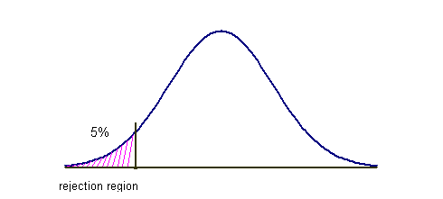
One-Tail Tests
A company claims that its batteries have an average life of at least 500 hours. How would you formulate this?
Answer: H₀: µ ≧ 500 hours H₁: µ < 500 hours
If you are testing at an α = .05, The entire .05 is in the left tail (hint: H₁ points to where the rejection region should be.) The critical value is -1.645.

Slide 14
One-Tail Tests
A company claims that its overpriced, bottled spring water has no more than 1 mcg of benzene (poison). How would you formulate this:
Answer: H₀: µ ≦ 1 mcg. benzene H₁: µ > 1 mcg. benzene
If you are testing at an α = .05, The entire .05 is in the right tail (hint: H₁ points to where the rejection region should be.) The critical value is +1.645.

Slide 15
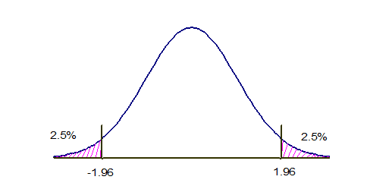

Example: Two-Tail Test
A pharmaceutical company claims that each of its pills contains exactly 20.00 milligrams of Cumidin (a blood thinner). You sample 64 pills and find that the sample mean X̅ =20.50 mg and s = .80 mg. Should the company’s claim be rejected? Test at α = 0.05.
Formulate the hypotheses
H₀: µ =20.00 mg H₁: µ ≠ 20.00 mg
Choose the test statistic and find the critical values; draw region of rejection
Test statistic: Z
At α = 0.05, the critical values are ±1.96.
Use the data to get the calculated value of the test statistic
Z = = = 5 [ .80/√.64 = .10 This is the standard error of the mean. ]
Come to a Conclusion: Reject H₀ or Do Not Reject H₀
The computed Z value of 5 is deep in the region of rejection. Thus, Reject H₀ at p < .05

Slide 16
Example: Two-Tail Test
Suppose we took the above data, ignored the hypothesis, and constructed a 95% confidence interval estimator.
20.50 ± 1.96(.10)
95%, CIE: 20.304 mg ←→ 20.696 mg
We note that 20.00 mg is not in this interval.
As you can see, hypothesis testing and CIE are virtually the same exercise; they are merely two sides of the same coin. Both rely on the sample evidence.
If a claim is made about a parameter, do a hypothesis test. If no claim is made and a company wants to use sample evidence to estimate a parameter (perhaps to determine what claims may be made in the future about a parameter), construct a confidence interval estimator.

Slide 17
Example: One-Tail Test
A company claims that its LED bulbs will last at least 8,000 hours. You sample 100 bulbs and find that X̅ =7,800 hours and s=800 hours. Should the company’s claim be rejected? Test at α = 0.05.
H₀: µ ≧ 8,000 hours H₁: µ < 8,000 hours
Z = 7,800 – 8,000 / (800/√100) = -200/80 = -2.50
[800/√100 = 80, the standard error of the mean]
The computed Z value of -2.50 is in the region of rejection. Thus, reject H₀ at p < .05
Note: When testing a hypothesis, we often have to perform a one-tail test if the claim requires it. However, we will always use only two-sided confidence interval estimators when using sample statistics to estimate population parameters.

